Slide 1
Hi-C data analysis handbook
Chengchen ZHAO, Zheting ZHANG, Zejie LING, Wei SHI, Tianci KONG, Tiancheng Yu, Yuxiang YAO, Maoxiang Shi, Jingyu YANG, Yuhao WU
2025.3.20

Slide 2
Outline
Experiment Overview (Shi Maoxiang, Yu Tiancheng)
Pre-process Pipeline/plus majsat (Yu Tiancheng, Shi Wei)
Quality control, stats summary, resolution evaluation (Yu Tiancheng, Shi Wei)
Sample correlation, PCA (Kong Tianci, Yang Jingyu)
Matrix balancing, Format transformation(Yao Yuxiang, Lin Zejie)
Downstream Analysis
TAD boundaries/TAD strength: aggregate plot，boundary-DI/IS, boundaries overlap，Consolidation score, TADcompare (Shi Maoxiang, Kong Tianci)
Compartment：Saddle，bw， bed， transition(Shi Wei, Zhang Zheting)
Loop： aggregate, bedpe, arc(Lin Zejie, Zhang Zheting)
3D reconstruction: HiC-kit, FLAMINGO(Zhang Zheting, Wu Yuhao)
PSS: line, heatmap(Yao Yuxiang, Yang Jingyu)
Contact compare： heatmap， HiCcompare, bedpe, arc (Wu Yuhao, Kong Tianci)
Tricks
Extension & Limitation

Slide 3
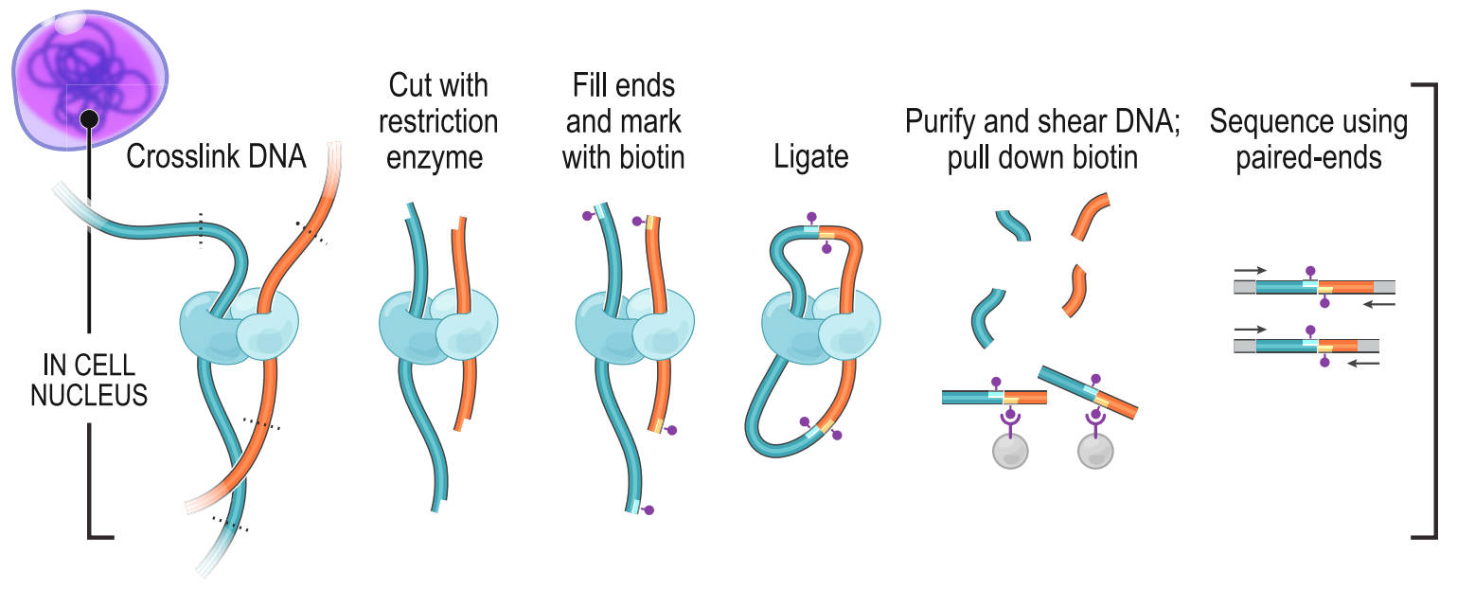
Experiment Overview
HiC Experiment
Lieberman-Aiden 2009 Rao 2014
Credit : Maoxiang Shi

Slide 4
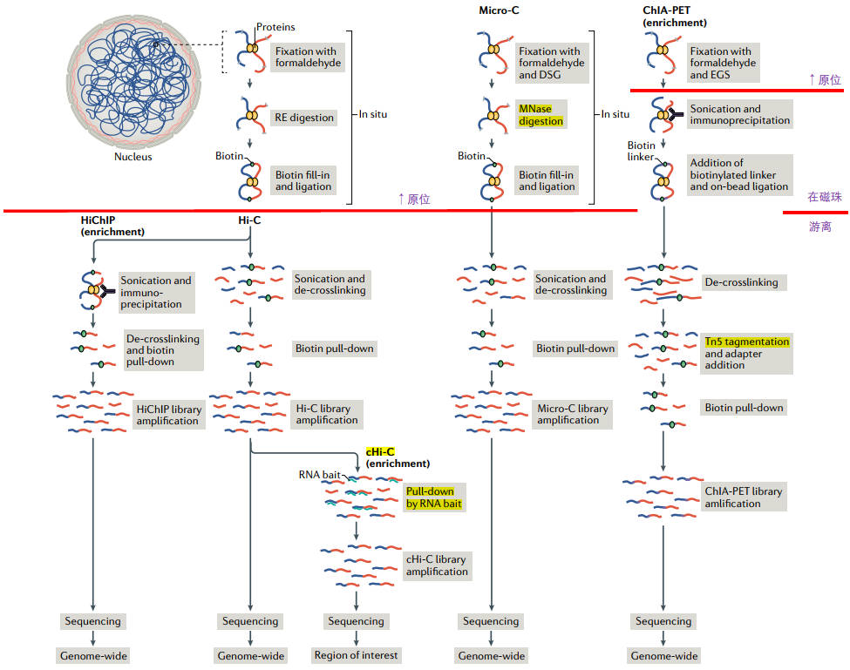
Experiment Overview
Jerkovic 2021 10.1038/s41580-021-00362-w
Credit : Maoxiang Shi

Slide 5
Pre-process Pipeline
Bwa-mem; pairtools (add majsat or not ?)😊
HiCpro 😐
测序数据量=目标区域大小×测序深度
1
Raw data vs. Clean data？

Slide 6
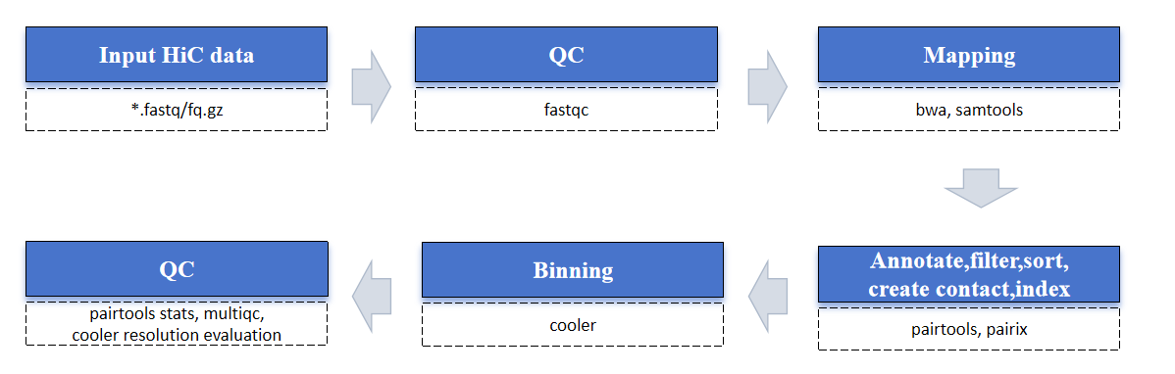
Pre-process Pipeline
Credit : Wei Shi, Zejie Lin

Slide 7
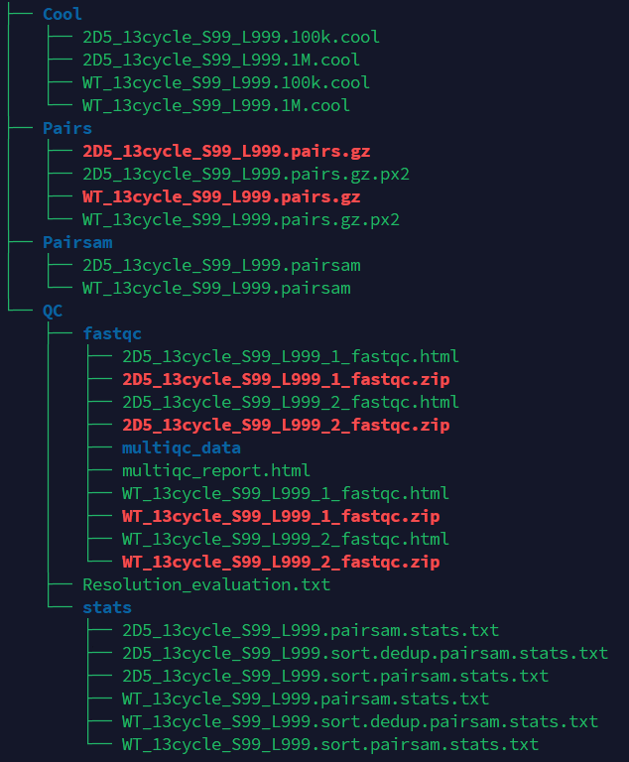
Preprocess
- Preprocess
Tools：CDesk
Input command line:
CDesk HiC preprocess \
-i /mnt/linzejie/CDesk_test/data/5.HiC/1.preprocess -s mm10_plusmajsat \
-o /mnt/linzejie/CDesk_test/result/5.HiC/1.preprocess/test \
-t 100 -f -r 100000,1000000
Typical Parameter:
参数^{√必要} | 描述 | 默认值
-i√ | fq文件输入文件夹 | -
-o√ | 输出文件夹 | -
-s,--species√ | 物种 | mm10,rn7,hg38,susScr11,galGal6,mm10_plusmajsat
-t,--thread | 使用进程数 | 10
-f,--filter | 是否进行更严格的过滤，参数参考Ruan Lab
-l | 1(单端测序)，2（双端测序） | 2
-r,--resolution | 生成的cool文件的分辨率,逗号分隔 | 1000

Slide 8
Quality control
QC of sequencing
QC of library construction
Final valid pairs
Duplication level
Pair type proportion
Resolution evaluation (proportion of bins that overlap with more than 1000 pairs)

Slide 9
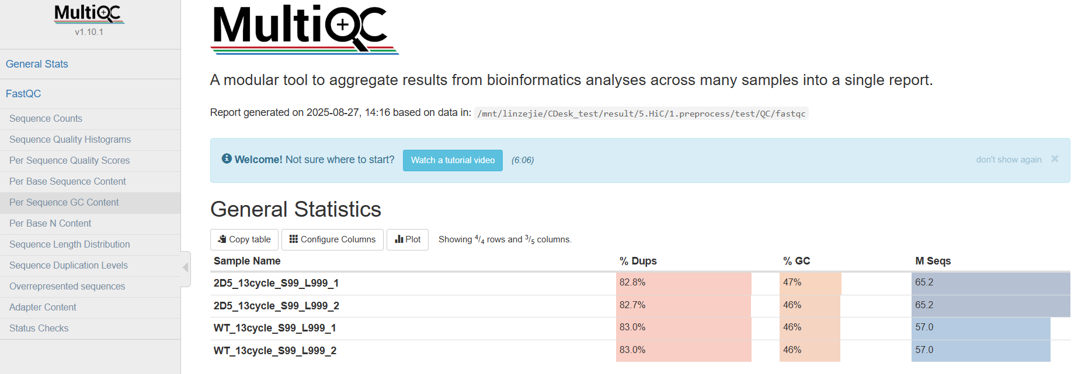
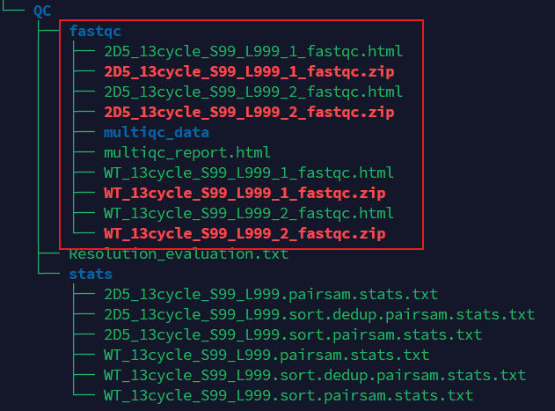
QC of sequencing
Tool：fastqc, multiqc
Credit : Zejie Lin

Slide 10
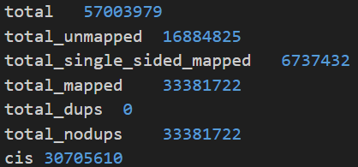
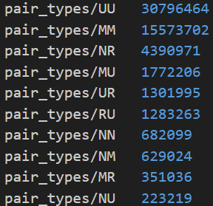
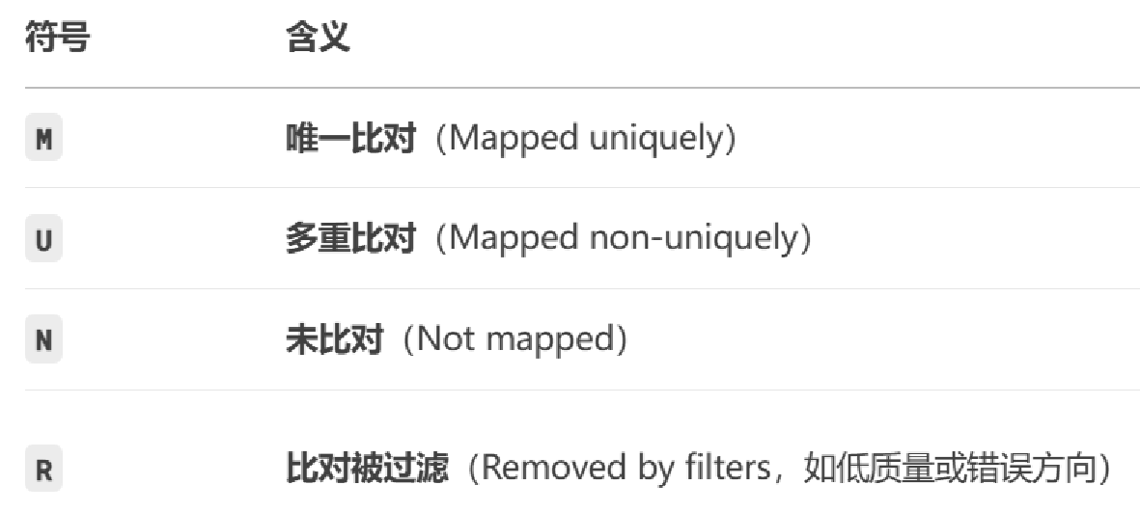
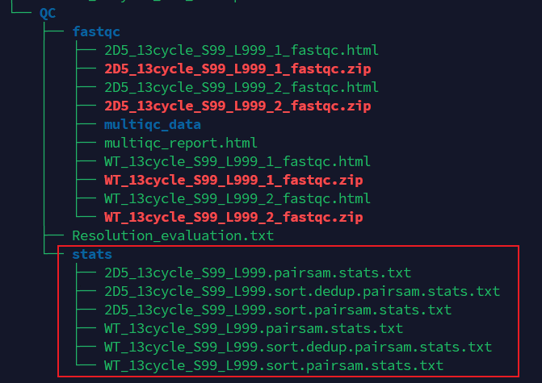
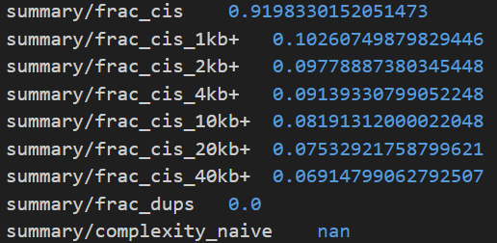
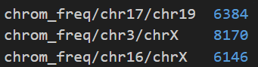
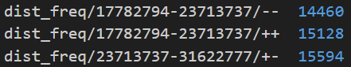
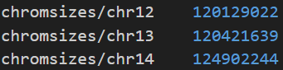
QC of library construction
Tool：pairtools stats
Result：
Total read pairs
Unmapped read pairs
Single-sided mapped read pairs
Valid mapped read pairs (both ends aligned)
PCR duplicate read pairs
Unique (non-duplicate) read pairs
Valid cis-interaction read pairs
Proportion of intra-chromosomal interaction read pairs
Number of read pairs between chr16 and chrX
Number of reads with a
distance of 237-316 Mb and +/− strand orientation
Total interaction read pairs on chr12
Credit : Wei Shi

Slide 11
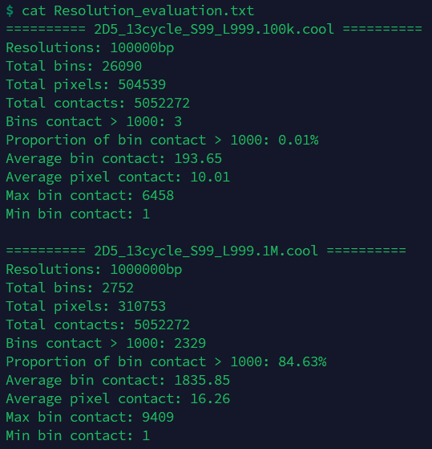
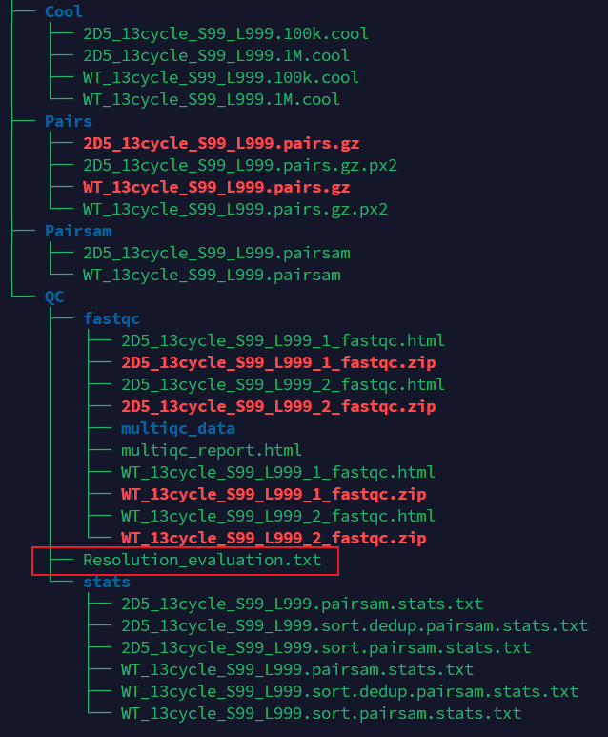
QC of resolution evaluation
Tool：cooler
Credit : Zejie Lin

Slide 12
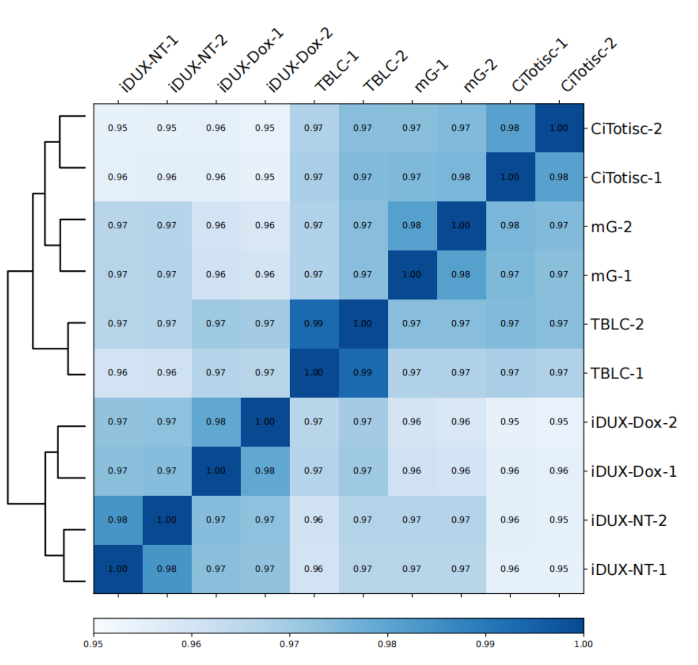
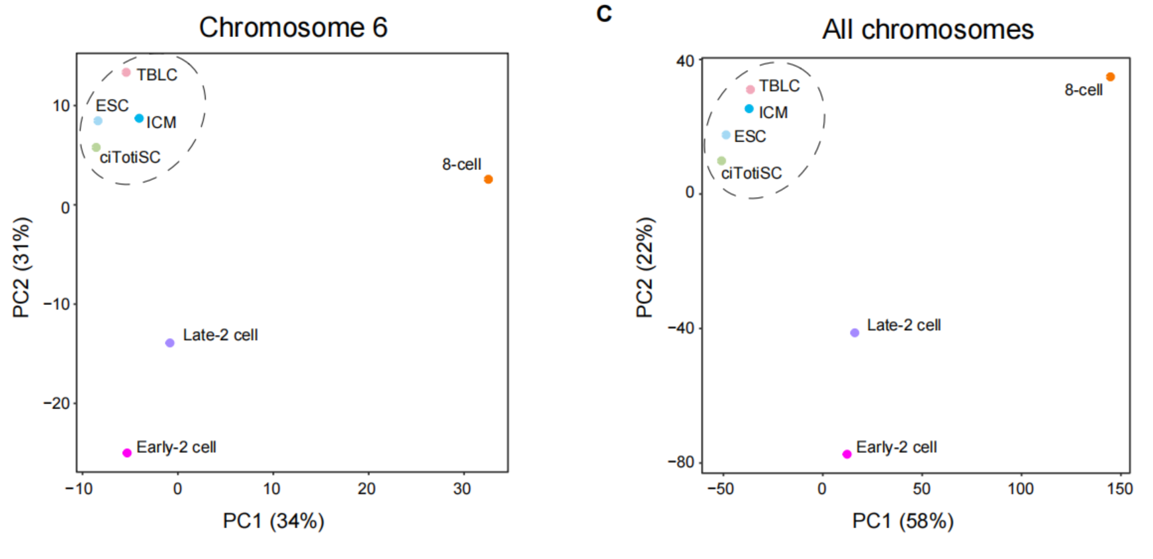
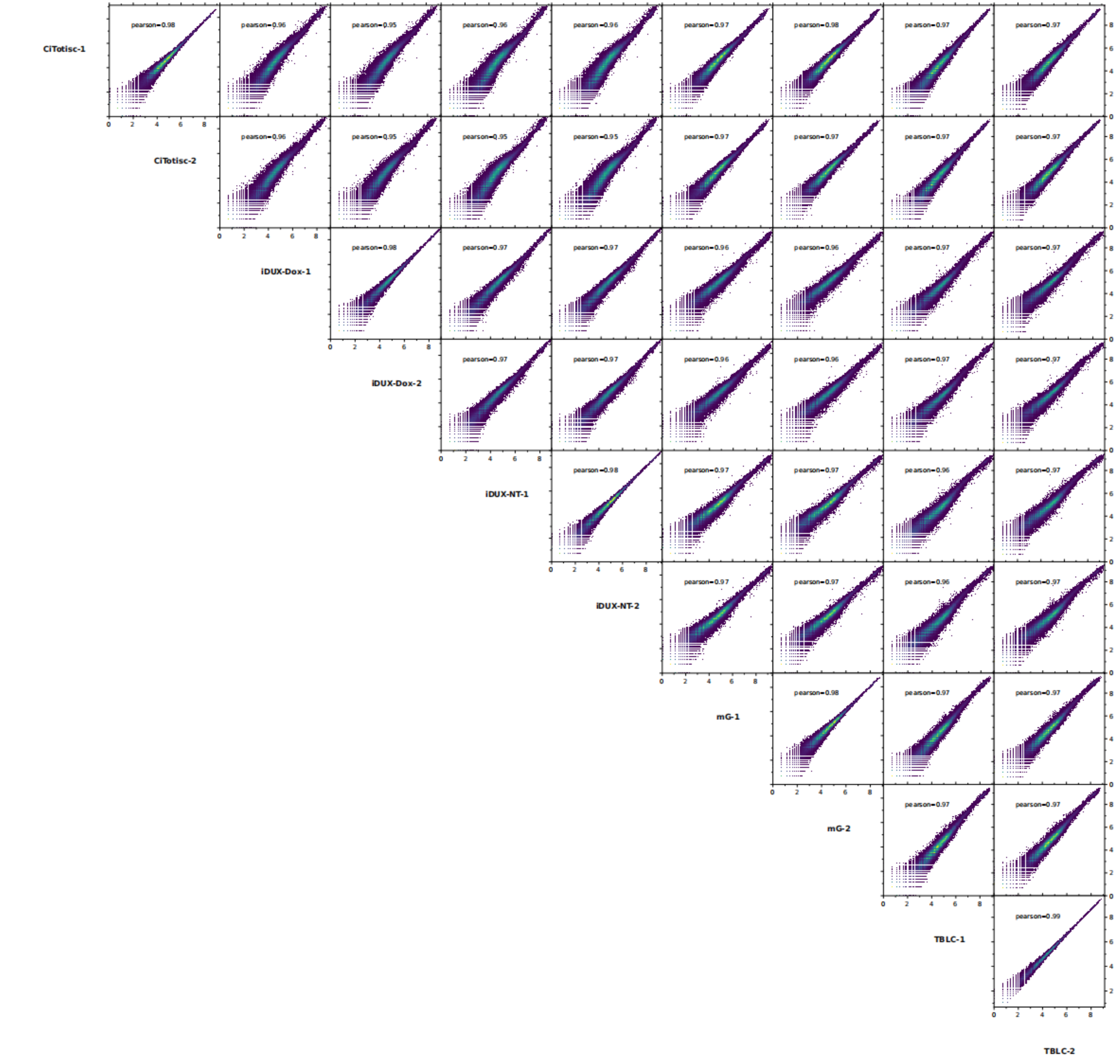
Sample correlation
Correlation between repeats (hicCorrelate, eigenvector 1 correlation)
PCA (PCA of filtered/all pixels (O/E matrix))
Multi resolutions!

Slide 13
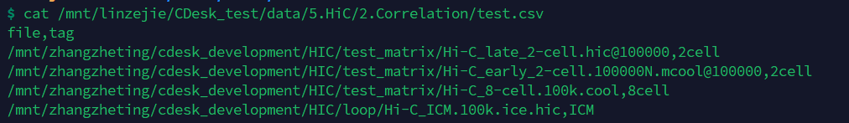
Sample correlation
Get common region pair O/E from input HiC samples
Compare different O/E matrices to each other
Correlation
PCA
Input csv file:
file: fanc supported hic input
tag: for plotting heatmap and PCA
Credit : Jingyu Yang, Zejie Lin

Slide 14
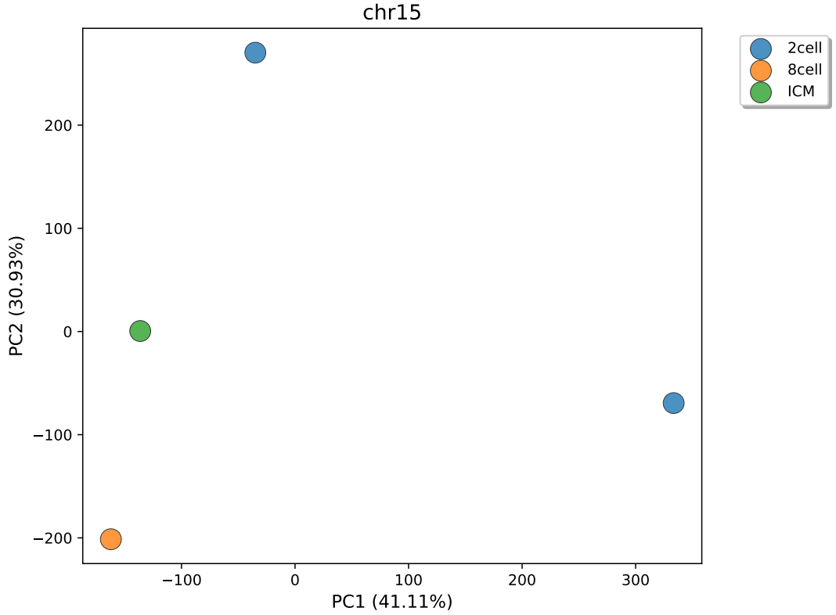
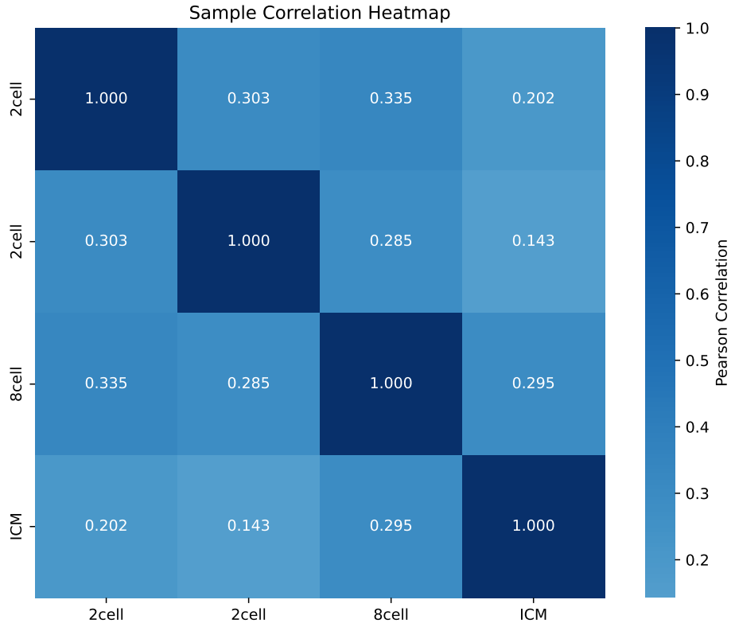
Sample correlation
- Correlation
Tools：CDesk
Input command line:
CDesk HiC correlation \
-i /mnt/linzejie/CDesk_test/data/5.HiC/2.Correlation/test.csv \
-o /mnt/linzejie/CDesk_test/result/5.HiC/2.Correlation/chr15 \
--chr chr15
Typical Parameter:
参数^{√必要} | 描述 | 默认值
-i√ | hic样本信息csv文件 | -
-o√ | 输出文件夹 | -
--chr | 指定染色体 | No
--inter_chrom | 是否包括染色体间信号
--width | 图片宽度 | 8
--height | 图片高度 | 6
Notes:
13min

Slide 15
Matrix balancing, Format transformation
Matrix balancing/normalization: O/E; KR; ICE; coverage ….
Main formats: .hic; cool; mcool; h5; paris; pre; text(7 columns); text(N*N matrix)
Multi resolutions!

Slide 16
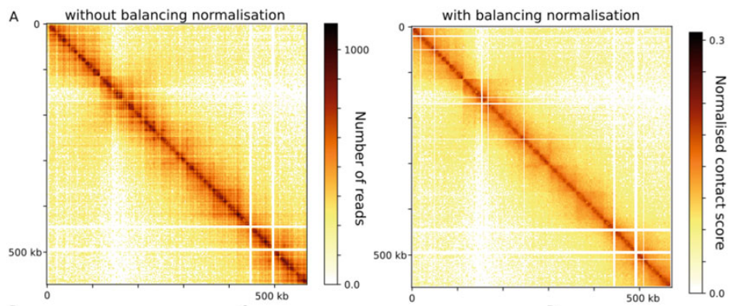
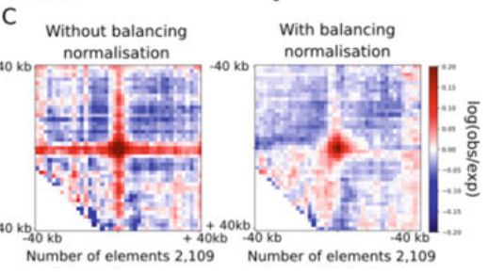
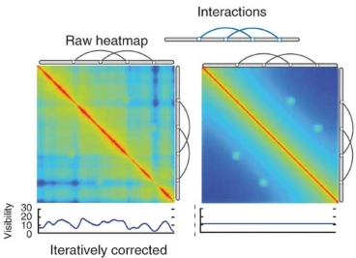
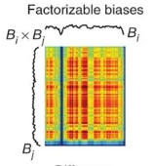
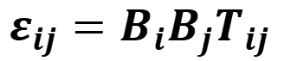
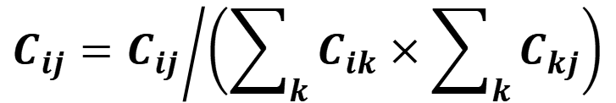
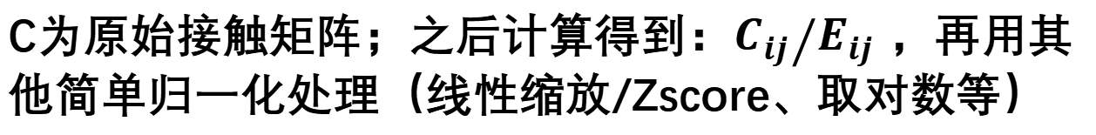
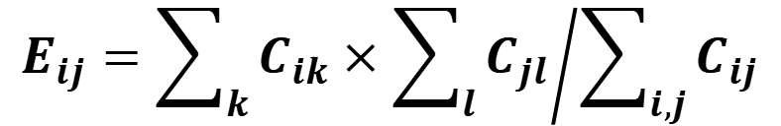
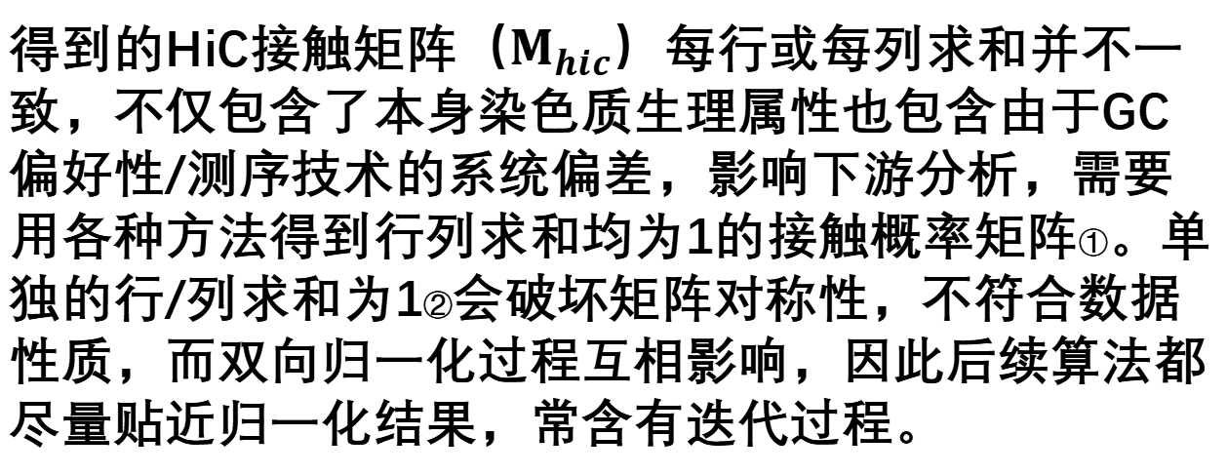
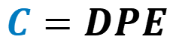
Matrix balancing
REF:[1]
矩阵平衡：
得到的HiC接触矩阵（$M_{hic}$）每行或每列求和并不一致，不仅包含了本身染色质生理属性也包含由于GC偏好性/测序技术的系统偏差，影响下游分析，需要用各种方法得到行列求和均为1的接触概率矩阵①。单独的行/列求和为1②会破坏矩阵对称性，不符合数据性质，而双向归一化过程互相影响，因此后续算法都尽量贴近归一化结果，常含有迭代过程。
ICE（Iterative Correction and Eigenvector decomposition）[3,4]
与SCE类似，分析每个位置的偏差系数得到真实分布：
O/E（Observed/Expected）
$$ε_{ij}={B_{i}B_{j}T}_{ij}$$
识别远程互作行为：
$$E_{ij}={\sum_{k}{C_{ik}}×\sum_{l}{C_{jl}}}/{\sum_{i,j}{C_{ij}}}$$
C为原始接触矩阵；之后计算得到：${C_{ij}}/{E_{ij} }$，再用其他简单归一化处理（线性缩放/Zscore、取对数等）
KR方法（ Knight-Ruiz balancing algorithm）[5]
SCE（Sequential Component Normalization）[2]
形式上像奇异值分解，找到两个对角标度矩阵（diagonal scaling）D和E，利用关系式求解平衡矩阵P：
$$C_{ij}={C_{ij}}/{\left(\sum_{k}{C_{ik}}×\sum_{k}{C_{kj}}\right)}$$
原始取bin矩阵
$$C=DPE$$
平衡矩阵(行列和为1)
*更详细理论分析见引文
Credit : Yuxiang Yao
Notes:
①这种归一化方法基于一个前提：各区域应具有相似的可检测性。若某个分箱出现覆盖不足或过度覆盖的情况，这可能源于实验方案的限制。
②SCE、ICE是去趋势偏差方法，并不严格等于1，KR方法是等于1的。
Ref:
[1] Garcia-Luis J, Lazar-Stefanita L, Gutierrez-Escribano P et al (2019) Fact mediates cohesin function on chromatin. Nat Struct Mol Biol 26 (10):9700–9979
[2] Cournac, A., Marie-Nelly, H., Marbouty, M. et al. Normalization of a chromosomal contact map. BMC Genomics 13, 436 (2012). https://doi.org/10.1186/1471-2164-13-436
[3] Imakaev M, Fudenberg G, McCord RP et al (2012) Iterative correction of hi-c data reveals hallmarks of chromosome organization. Nat Methods 9(10):9990–1003
[4] Yaffe, E. & Tanay, A. Probabilistic modeling of Hi-C contact maps eliminates systematic biases to characterize global chromosomal architecture. Nat. Genet. 43, 1059–1065 (2011).
[5] Knight PA, Ruiz D (2012) A fast algorithm for matrix balancing. IMA J Numer Anal 33 (3):1029–1047

Slide 17
Matrix balancing, Format transformation
h5
hicConvertFormat
cool
mcool
juicer hic
pairs
fanc hic
fanc to-cooler
cooler zoomify
juicer pre
juicer hic
fanc hic
cool
mcool
hicConvertFormat
h5
inputFormat
outputFormat
h5
cool
mcool
juicer hic
fanc hic
pairs
h5
cool
mcool
juicer hic
fanc hic

Slide 18
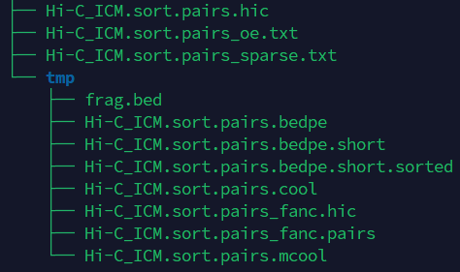
Matrix balancing, Format transformation
- Matrix balancing & Format transformation
Tools：CDesk
Input command line:
CDesk HiC matrix \
-i /mnt/zhangzheting/cdesk_development/HIC/test_matrix/Hi-C_ICM.sort.pairs.gz \
-o /mnt/linzejie/CDesk_test/result/5.HiC/matrix/pairs_to_juicerhic \
--inputFormat pairs --outputFormat juicerhic \
--oe 300000 --sparse 300000 -t 50 -n VC \
-r 300000,400000 --species mm10
Typical Parameter:
参数^{√必要} | 描述 | 默认值
-i√ | 输入文件 | -
-o√ | 输出文件夹 | -
--inputFormat√ | 输入文件类型 | {pairs,cool,mcool,juicerhic,fanchic,h5}
--outputFormat√ | 输出文件类型 | {cool,mcool,juicerhic,fanchic,h5}
-t, --thread | 进程数 | 10
-r, --resolution | 分辨率 | -
参数^{√必要} | 描述 | 默认值
-n, --norm | 标准化方法 | None {KR,ICE,VC,VC-SQRT,None}
-oe | 转存O/E文件 | -（指定分辨率）
--sparse | 转存文件 | -（指定分辨率）
-s, --species | 物种 | - (mm10,rn7,hg38,susScr11,galGal6)

Slide 19
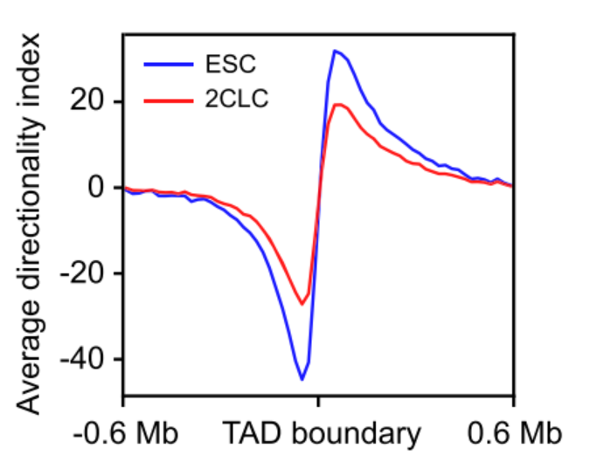
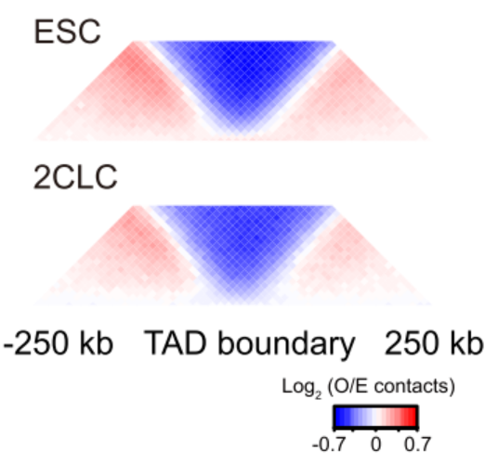
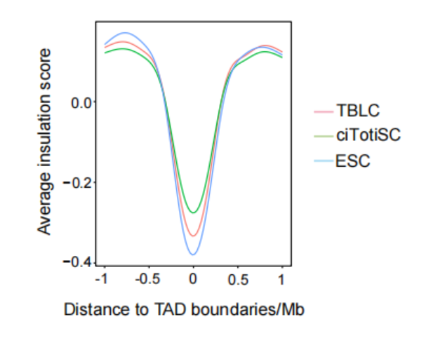
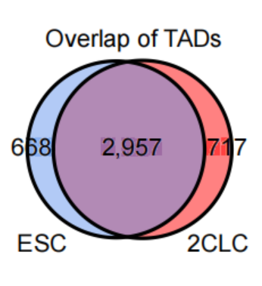
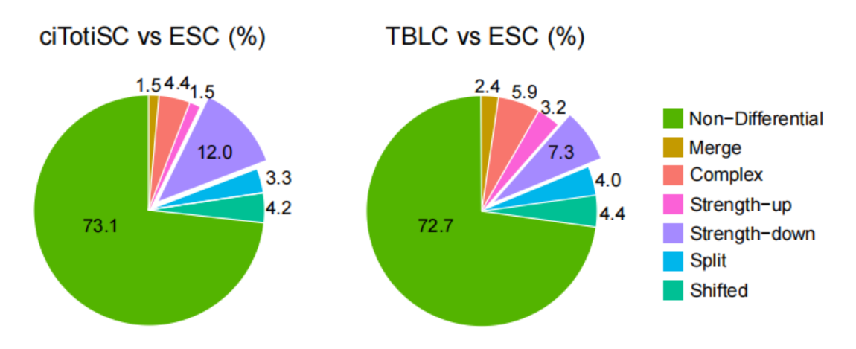
TAD related
TAD boundaries
Insulation score
Dictionary index
Conservation of TADs (Venn plot, aggregate plot)
TADcompare(R package)
TAD strength: output the bed files
Multi high resolutions!

Slide 20
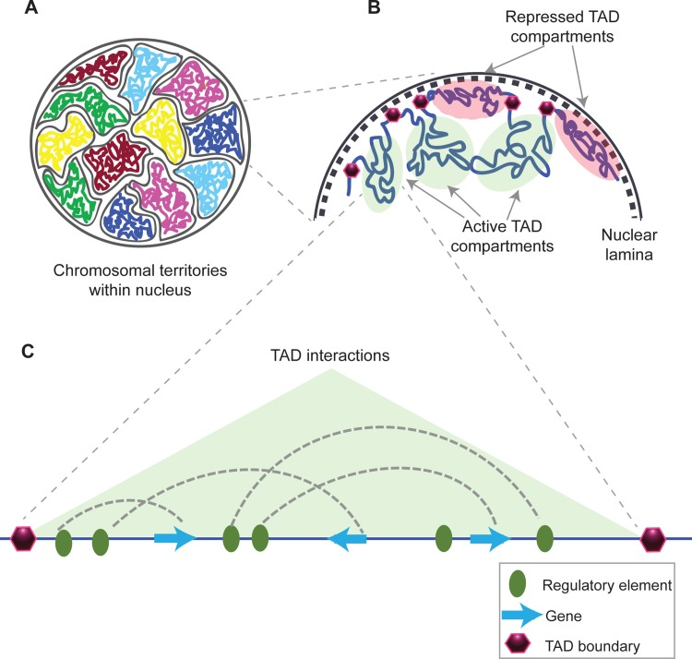
TAD related
TAD
TADs (Topologically Associating Domains) are genomic regions that interact frequently within chromatin compartments.
Generally conserved across different cells and mammalian species, and are highly enriched for CTCF and cohesin proteins.
Typically range from 400 to 800 kb in size and represent stable replication units
Matharu N, Ahituv N. Minor Loops in Major Folds: Enhancer-Promoter Looping, Chromatin Restructuring, and Their Association with Transcriptional Regulation and Disease. PLoS Genet. 2015 Dec 3;11(12)
Credit : Zejie Lin
Notes:
在染色质区室中互相作用相对频繁的基因组区域，这些就是拓扑结构域 TAD。
一般这些区域在不同的哺乳动物的不同细胞中都很保守，并且高度富集 CTCF 和 粘附蛋白。
通过计算基因互作矩阵，大三角形中几个深红色的三角代表内部高度互作域被定义为拓扑结构域，一般是400-800kb较稳定的复制单元。

Slide 21
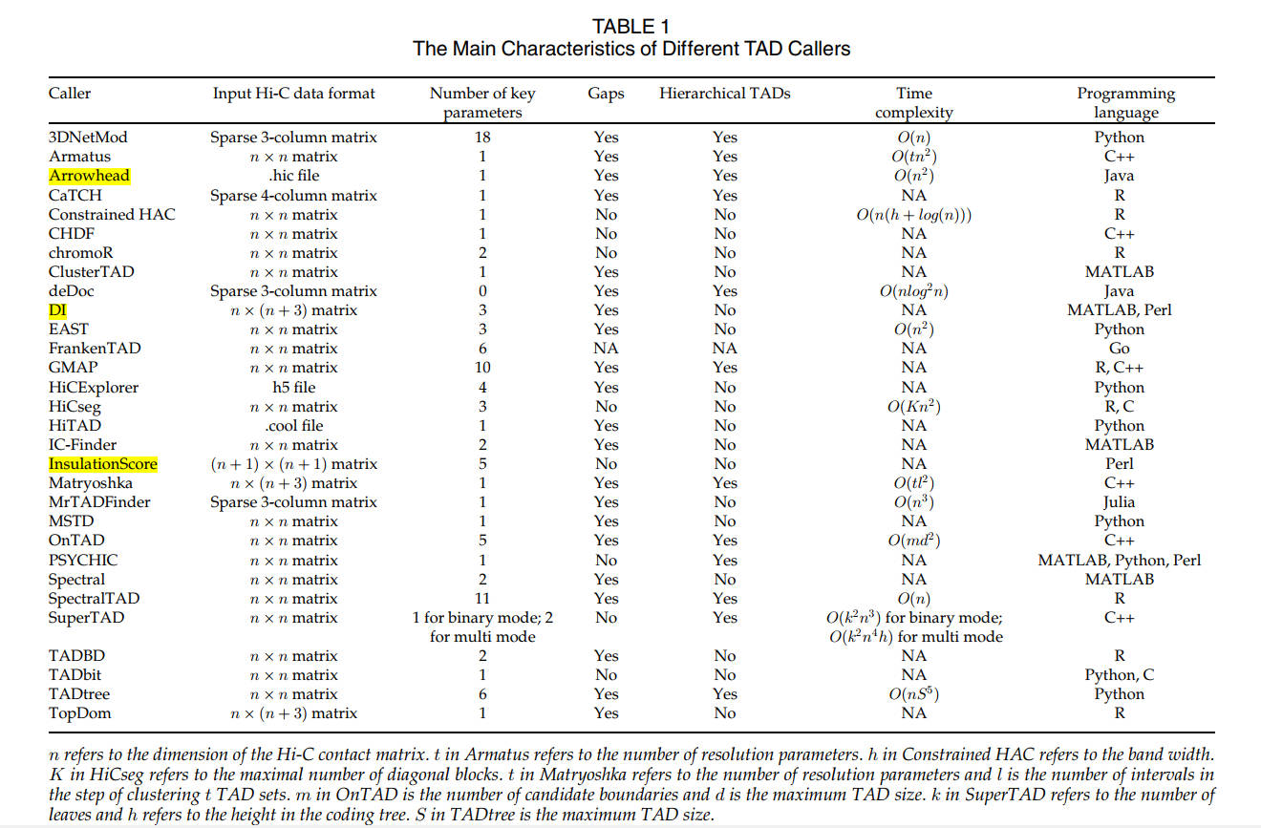
TAD related
TAD methods
A Comparison of Topologically Associating Domain Callers Based on Hi-C Data
https://doi.org/10.1109/tcbb.2022.3147805
Credit : Maoxiang Shi

Slide 22
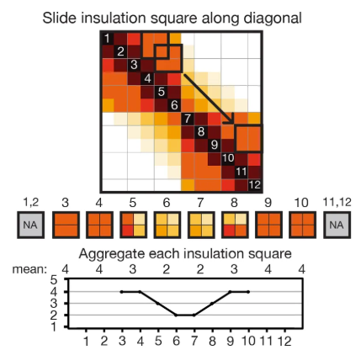
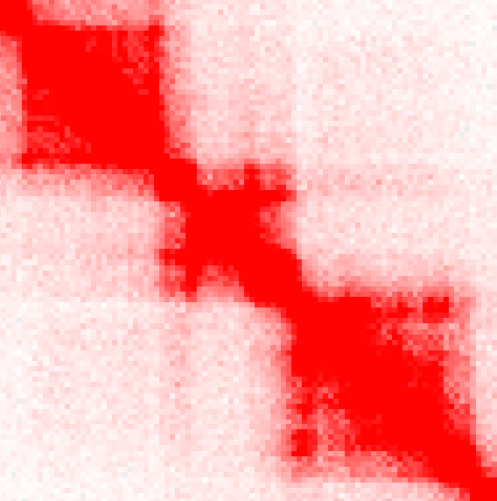
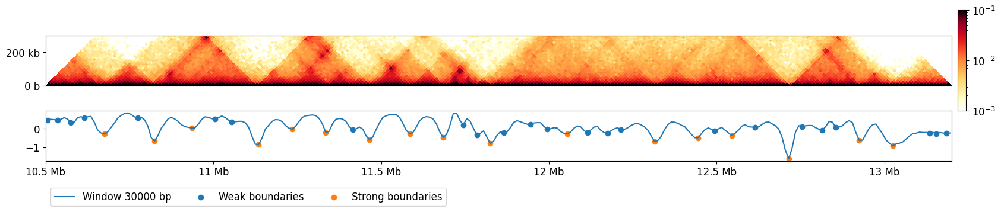
TAD related
Identification of TADs: insulation score (IS)
1Mb
Credit : Maoxiang Shi

Slide 23
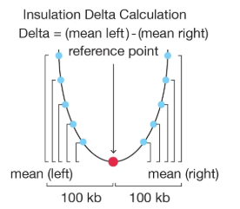
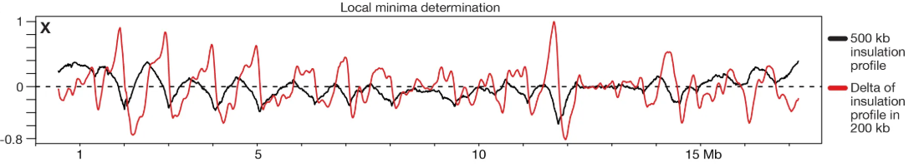
TAD related
Insulation score
基因组上，局部最小点即为 TAD 边界。
需要：设置阈值、排除假阳性
Credit : Maoxiang Shi

Slide 24
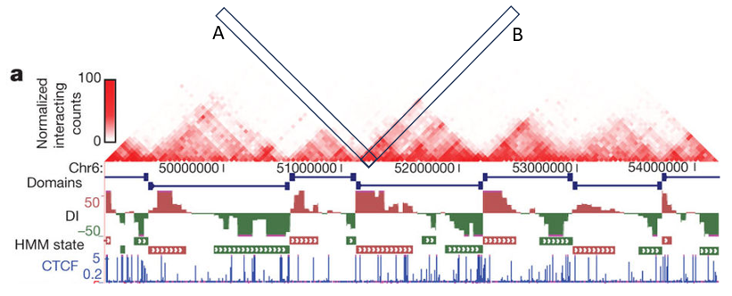
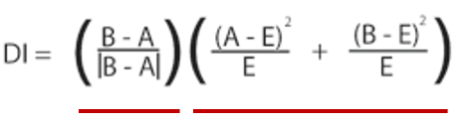
TAD related
Identification of TADs: Directionality Index (DI)
 | 理论 | 实际
上游 | E | A
下游 | E | B
B: Interaction frequencies with the downstream bins
A: Interaction frequencies with the upstream bins
E = (A+B)/2: expected interaction under null hypothesis.
正负号
卡方检验量
零假设：上下游互作没有显著差别
上下游存在显著差别的点，即为 TAD 边界点
Dixon et al, 2012
Credit : Maoxiang Shi

Slide 25
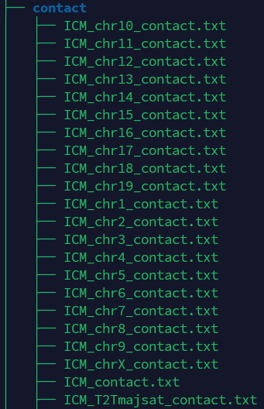
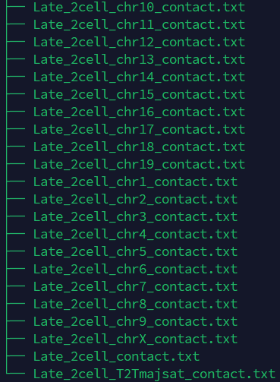
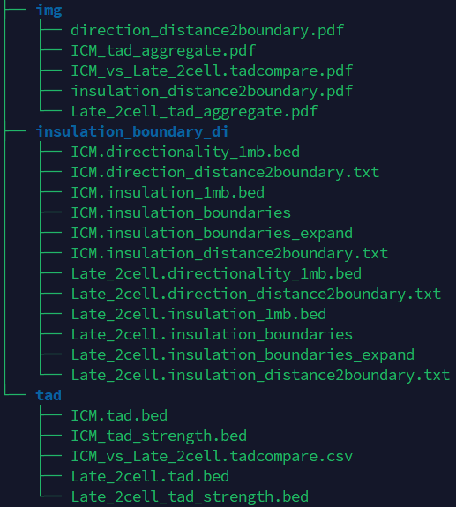





TAD related
- TADs
Tools：CDesk
Input command line:
CDesk HiC TAD \
-i /mnt/linzejie/CDesk_test/data/5.HiC/4.TAD/test1.csv \
-o /mnt/linzejie/CDesk_test/result/5.HiC/4.TAD/test1 \
--insulation_window 1000000 --directionality_window 1000000 \
--expand 1000000
Typical Parameter:
参数^{√必要} | 描述 | 默认值
-i,--input√ | hic样本信息文件 | -
-o,--output√ | 输出文件夹 | -
--insulation_window | insulation score计算窗口 | 1000000
--directionality_window | directionality index计算窗口 | 1000000
--expand | boundary扩展 | 1000000

Slide 26

Compartment related
Eigenvector calculation(covariance applied for phasing is needed)
A/B compartment
A/B transit
Saddle plot (compartment strength)
Bed files; bw files
Multi low/middle resolutions!

Slide 27


Compartment related
The genome partitions into two spatial compartments that display high intra-compartment but low inter-compartment contact frequencies.
A Compartment (Active)
Open, accessible chromatin
Transcriptionally active; gene-rich, GC-rich
Enriched for active histone marks (e.g., H3K4me3, H3K27ac)
Preferentially located in the nuclear interior
B Compartment (Inactive)
Closed, compact chromatin
Transcriptionally silent; gene-poor
Enriched for repressive histone marks; overlaps lamina-associated domains – Located at the nuclear periphery; contains late-replicating origins
A vs. B compartments are distinguished by computing the correlation matrix of intra-chromosomal Hi-C contacts and extracting PC1; positive PC1 values denote A, negative PC1 values denote B.
Matharu N, Ahituv N. Minor Loops in Major Folds: Enhancer-Promoter Looping, Chromatin Restructuring, and Their Association with Transcriptional Regulation and Disease. PLoS Genet. 2015 Dec 3;11(12)
Credit : Zejie Lin

Slide 28




Calculate eigenvalues
Convert single-resolution data to multi-resolution data
Tool：cooler zoomify
Result：
Calculate expected interaction frequencies across genomic distance bins
Tool：cooltools expected-cis
Result：
Compute GC content across genomic intervals
Tool：cooler dump/cooltools genome gc
Result：
Derive interaction eigenvalue profiles across intervals
Tool：cooltools eigs-cis
Result：
E1的正负代表AB Compartment类型
Credit : Wei Shi

Slide 29


SaddlePlot
Tool：cooltools
Result：
The x-axis and y-axis represent binned eigenvalues
the top-left quadrant shows B-B interaction strength
the bottom-right quadrant shows A-A interaction strength
Strength=（AA*BB）/（AB*AB）
URL：https://cooltools.readthedocs.io/en/latest/notebooks/compartments_and_saddles.html
Credit : Wei Shi

Slide 30

A/B transit
To calculate the number of AB compartment switches between two samples
Credit : Wei Shi

Slide 31






Compartment related
- Compartment analysis
Tools：CDesk
Input command line:
CDesk HiC compartment \
-m /mnt/linzejie/CDesk_test/data/5.HiC/6.compartment/test.csv \
-o /mnt/linzejie/CDesk_test/result/5.HiC/6.compartment_1 \
(--GC /mnt/zhangzheting/pubdata/Xiewei/l2c/wt.100k.atac.bed \)
-t 30 --width 10 --height 8 -r 100000 -s mm10
Typical Parameter:
参数^{√必要} | 描述 | 默认值
-m,--meta√ | cool信息文件 | -
-r,--resolution√ | 指定分辨率 | -
-o,--output√ | 输出文件夹 | -
-t,--thread | 进程数 | 20
--GC | GC文件
-s,--species | 物种 | mm10,rn7,hg38,susScr11,galGal6,mm10_plusmajsat
--width | 作图宽度
--height | 作图高度

Slide 32

Loop calling
Loop calling
Aggregate plot; loop strength
Bedpe files; arc files
Multi high/middle resolutions!

Slide 33



Loop calling
Chromatin loops
Chromatin can form loop structures in 3D space, allowing distant chromatin regions to come into close proximity. ≈ 50% of human genes participate in long-range chromatin interactions through chromatin looping.
This structural organization enables regulatory elements that are far apart in linear distance to meet in space, thereby modulating biological processes—for example, by bringing promoters and enhancers into proximity to facilitate transcription initiation.
In this process, enhancer elements that interact with promoters can recruit a variety of protein complexes, such as mediator complexes, the pre-initiation complex (PIC), and cell-specific transcription factors.
Additionally, several factors contribute to chromatin looping, including architectural proteins (mainly CTCF and Cohesin), co-activators, and non-coding RNAs (ncRNAs).
Rao SS, Huntley MH, Durand NC, Stamenova EK, Bochkov ID, Robinson JT, Sanborn AL, Machol I, Omer AD, Lander ES, Aiden EL. A 3D map of the human genome at kilobase resolution reveals principles of chromatin looping. Cell. 2014 Dec 18;159(7):1665-80.
Credit : Zejie Lin

Slide 34

Loop calling
Use fanc loops to call loops in Hi-C matrices using the HICCUPS algorithm
Annotate pixels with local enrichment, probability, and mappability information
Filter pixels based on suitable cutoffs to identify pixels that are part of a loop
Merge nearby pixels into a single loop call
Included the filter applied by Rao and Huntley et al. in their original HICCUPS algorithm.
It only retains peaks that are at least 2-fold enriched over either the donut or lower-left neighborhood, at least 1.5-fold enriched over the horizontal and vertical neighborhoods, at least 1.75-fold enriched over both the donut and lower-left neighborhood, and have an FDR <= 0.1 in every neighborhood.
Rao SS, Huntley MH, Durand NC, Stamenova EK, Bochkov ID, Robinson JT, Sanborn AL, Machol I, Omer AD, Lander ES, Aiden EL. A 3D map of the human genome at kilobase resolution reveals principles of chromatin looping. Cell. 2014 Dec 18;159(7):1665-80.
Credit : Zejie Lin

Slide 35


Loop Calling
- Loop calling
Tools：CDesk
Input command line:
CDesk HiC loop \
-i /mnt/linzejie/CDesk_test/result/5.HiC/matrix/cool_to_juicerhic/Hi-C_8-cell.100k.hic \
-o /mnt/linzejie/CDesk_test/result/5.HiC/7.loop/juicerhic
CDesk HiC loop \
-i /mnt/zhangzheting/cdesk_development/HIC/loop/Hi-C_ICM.100k.ice.hic \
-o /mnt/linzejie/CDesk_test/result/5.HiC/7.loop/fanc
Typical Parameter:
参数^{√必要} | 描述 | 默认值
-i√ | fanc支持输入的hic文件 | -
-o√ | 输出文件夹 | -
-t, --thread | 进程数 | 10

Slide 36
3D reconstruction
HiCkit (phasing/no-phasing mode)
FLAMINGO

Slide 37
3D reconstruction
- HiCkit
Tools：CDesk
Input command line:
CDesk HiC reconstruct hickit \
(--vcf /mnt/zhangzheting/reference/mm10/mgp.v5.merged.snps_all.dbSNP142.vcf.gz \
--mat C57BL_6NJ --pat PWK_PhJ \)
--r1 /mnt/zhangzheting/pubdata/Xiewei/allelic/Hi-C_ICM_rep3/Hi-C_ICM_rep3_1_val_1.fq.gz \
--r2 /mnt/zhangzheting/pubdata/Xiewei/allelic/Hi-C_ICM_rep3/Hi-C_ICM_rep3_2_val_2.fq.gz \
--species mm10 --prefix nophase -t 100 -o /mnt/linzejie/hickit_test_phase
Typical Parameter:
参数^{√必要} | 描述 | 默认值
--r1√ | .hic read1文件 | -
--r2√ | .hic read2文件 | -
-o√ | 输出文件夹 | -
--species√ | 物种 | -
--vcf | SNP vcf压缩文件
--pat | 父本
--mat | 母本
--prefix | 输出前缀 | result
-t | 进程数 | 20

Slide 38
3D reconstruction
- Flamingo
Tools：CDesk
Input command line:
CDesk HiC reconstruct flamingo \
-i /mnt/zhangzheting/cdesk_development/HIC/test_matrix/Hi-C_8-cell.hic \
-o /mnt/linzejie/tmp/hic/flamingo \
--chr chr1 --domain_res 1e6 --frag_res 5e4 --normalization KR -t 50
Typical Parameter:
参数^{√必要} | 描述 | 默认值
-i√ | .hic文件(juicer格式) | -
-o√ | 输出文件夹 | -
--chr√ | 制定染色体 | -
--domain_res√ | domain分辨率 | -
--frag_res√ | fragment分辨率 | -
--normalization | 输出前缀 | NONE
-t | 进程数 | 10

Slide 39


Distance-contact
Distance - probability
PSS plot

Slide 40

Distance-contact
当完全随机时，两个碱基距离越远结合概率越小。一般以距离的负数阶乘多项式进行拟合，例如：
$$p\left(L\right)=aL^{−s1}+bL^{−s2}+δ(L^{−s3})$$
图2
结合实际情况，如数据不准确性和生理结合原理，一般考虑低阶即可。参考DuPeng文章，以s1=1为基准拟合：
图1
其他事项：
根据需要适当截断用于统计的互作长度区间，即作图横轴范围；
距离参考线$S^{−1}$近表明此处概率大于“期望值”，反之表示低于“期望值”，由此计算特定区间范围染色质在不同细胞类型/状态的互作行为变化；
绘制热图(图2)需要绝对差值，突出相比“期望”差值偏离的距离；
实际做法如下：
对指定长度的互作进行计数，得到“长度-频数”表；
将所有长度取log10，并根据输入的nBin数划分格子；
对处在同样格子内部的计数求和，得到“盒子-频数”表；
对频数取log10；
绘图（图1）
Credit : Yuxiang Yao
Notes:
用经典log-bin分箱绘制，曲线不直（此处$L^{−1}$存疑）。

Slide 41





Distance-contact
- PSS plot
Tools：CDesk
Input command line:
CDesk HiC pss \
-i /mnt/linzejie/CDesk_test/data/5.HiC/2.Correlation/test.csv \
-o /mnt/linzejie/CDesk_test/result/5.HiC/8.pss
Typical Parameter:
参数^{√必要} | --描述 | 默认值
--curve_x_min | 曲线图X轴最小截断值（含） | 4
--curve_x_max | 曲线图X轴最大截断值（含 | 8
--expcurve_y_bias | 期望曲线与期望差异时的Y轴偏移量 | -4
--expcurve_x_min | 与期望曲线差异时的X轴最小舍弃值 | 5
--expcurve_x_max | 与期望曲线差异时的X轴最大舍弃值 | 8
--heatmap_x_min | 热图的X轴范围最小值 | 4.8
--heatmap_x_max | 热图的X轴范围最大值 | 7.5
--height | 图片高度 | 10
--width | 图片宽度 | 6
参数^{√必要} | 描述 | 默认值
-i√ | hic文件信息csv文件 | -
-o√ | 输出文件夹 | -
--bin | 每一个数量级之间统计时划分的bin数量 | 20
--curve_mean_min | 绘制曲线时均值下界（不含） | 1e-6
--curve_bin_min | 绘制曲线时bin索引数下界（不含），即前X个bin不要绘制 | 0

Slide 42

Differential contact
HiCcompare
Delta heatmap

Slide 43
Differential contact
HiCcompare is an R-package for joint normalization and comparison of HI-C datasets
CDesk compare process:
1. Reads the .hic file and straw the contact matrix
2. Create hic.table object from a sparse upper triangular Hi-C matrix
3. Perform joint loess normalization on two Hi-C datasets
4. Detect differences between two jointly normalized Hi-C datasets.
5. MD plot visualization
6. Straw the o/e matrix and do delta plot visualization
Credit : Yuhao Wu, Zejie Lin

Slide 44

Differential contact
- Differential contact
Tools：CDesk
Input command line:
CDesk HiC compare \
--hic1 /mnt/zhangzheting/cdesk_development/HIC/test_matrix/Hi-C_early_2-cell.100000N.mcool@100000 \
--hic2 /mnt/zhangzheting/cdesk_development/HIC/test_matrix/Hi-C_8-cell.100k.cool \
-o /mnt/linzejie/CDesk_test/result/5.HiC/9.compare --chr chr5
Typical Parameter:
参数^{√必要} | 描述 | 默认值
--hic1√ | 第一个.hic文件(control) | -
-hic2√ | 第二个.hic文件 | -
-o√ | 输出位置 | -
--chr√ | 指定染色体 | -

